Slide 1
Aggregate functions

Slide 2
Introduction
An aggregate function performs a calculation on a set of values of a column, and returns a single value
Built-in aggregate functions
COUNT, SUM, MAX, MIN, and AVG
Functions can be used in the SELECT clause or in a HAVING clause

Slide 3
Example
Find the sum of the salaries of all employees, the maximum salary, the minimum salary, and the average salary.
SELECT SUM (Salary), MAX (Salary), MIN (Salary), AVG(Salary)
FROM EMPLOYEE;
Sum (Salary) | Max(Salary) | Min (Salary) | Avg (Salary)
986550 | 55000 | 25000 | 55600

Slide 4
Example
Find the total number of employees.
SELECT count(ssn)
FROM EMPLOYEE;
The above query will ignore nulls but not duplicates.
SELECT count(*)
FROM EMPLOYEE;
The above query will not ignore nulls & duplicates. count(*) counts the rows.
Count(ssn)
8
Count(*)
8

Slide 5
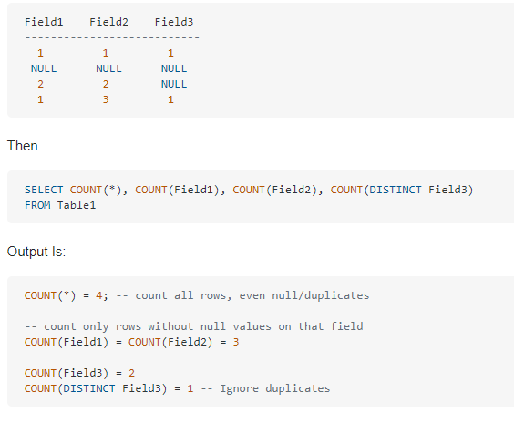
How Count() handles null values?

Slide 6
How to remove duplicates from result of count?
Count the number of distinct salary values in the database
SELECT COUNT (DISTINCT Salary)
FROM EMPLOYEE;
Output = 6

Slide 7
Group By
Aggregate functions are often used with the GROUP BY clause
GROUP BY Clause is used to collect data from multiple records and group the result by one or more column
Example: "find the number of employees in each department".
Select count(*), dno
From employee
Group by dno;
Count(*) | Dno
1 | 1
3 | 4
4 | 5

Slide 8
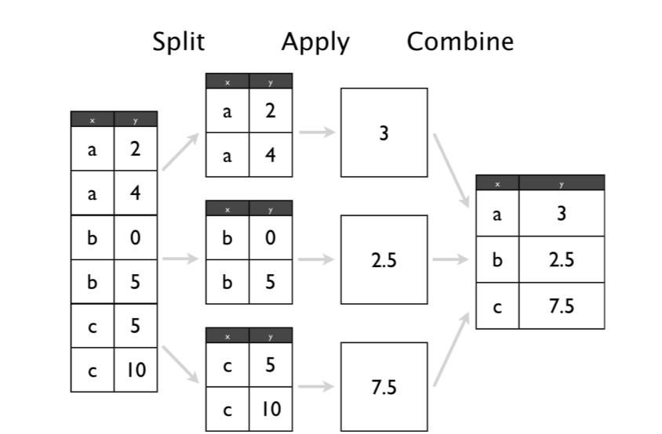

Slide 9
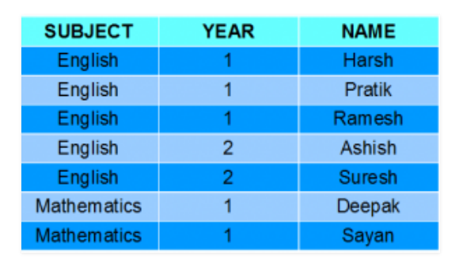
Group By Subject count ? Group By Year Count?

Slide 10
syntax
SELECT column_name(s) FROM table_name WHERE condition GROUP BY column_name(s) ORDER BY column_name(s);
find the number of employees in each department
Select dno, count (*)
From employee
Group by dno ;
Dno | Count(*)
4 | 3
5 | 4
1 | 1

Slide 11
Example:
For each department, retrieve the department number, the number of employees in the department, and their average salary.
SELECT Dno, COUNT (*), AVG (Salary)
FROM EMPLOYEE
GROUP BY Dno;
Dno | Count(*) | Avg(Salary)
4 | 3 | 30000
5 | 4 | 31000
1 | 1 | 55000

Slide 12
Practice:
For each project, retrieve the project number, the project name, and the number of employees who work on that project.

Slide 13
Practice:
For each project, retrieve the project number, the project name, and the number of employees who work on that project.
Select pnumber, pname, count(essn)
From workson join project on pno = pnumber
Group by pnumber;

Slide 14
For each project, retrieve the project number, the project name, and the number of employees from department 5 who work on the project.

Slide 15
For each project, retrieve the project number, the project name, and the number of employees from department 5 who work on the project.
Select pnumber, pname, count(essn)
From (project join workson on pno= pnumber) join employee on essn =ssn
Where dno = 5
group by pnumber;

Slide 16
Having Clause
Used for condition (just like where clause) on aggregate function’s result.
Having clause will not execute if there is no group by.

Slide 17
Example
Show department names which have more than two locations.
Select dname, count(dlocation) as total_locations
From department join dept_locations using (dnumber)
Group by dname
Having count(dlocation) >2 ;

Slide 18
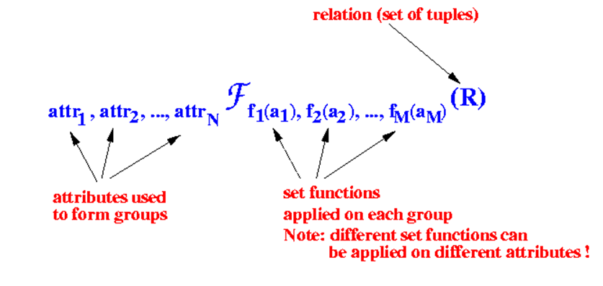
RA for aggregate functions

Slide 19
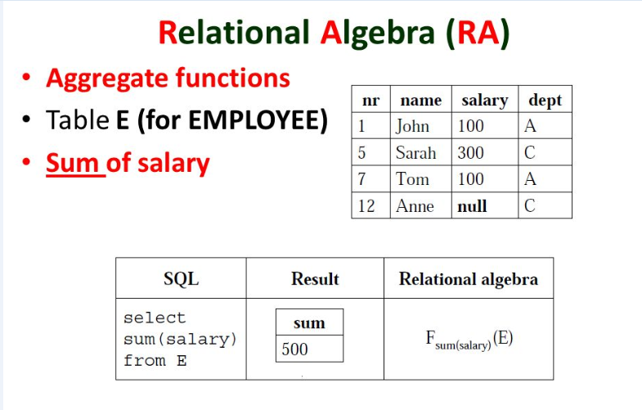

Slide 20
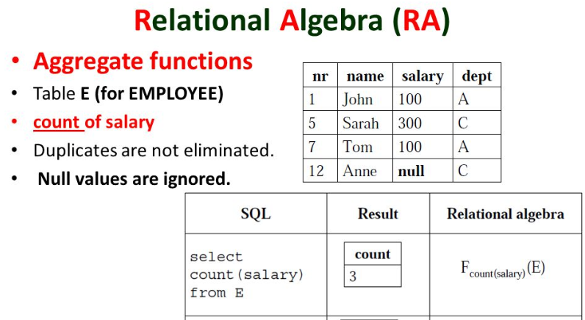

Slide 21
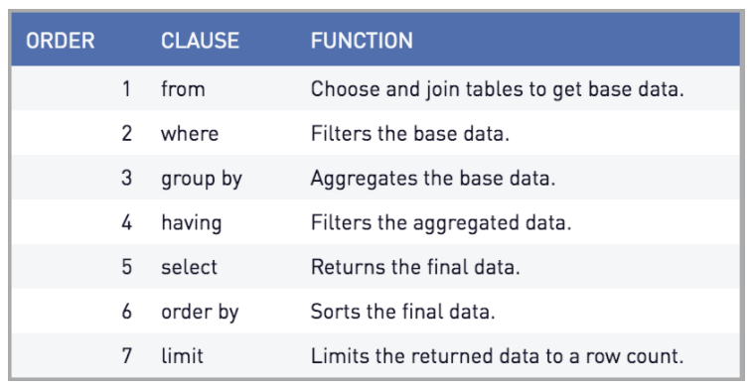
Order of execution

Slide 22
Practice Queries
Show average salary of all employees.
Show total number of departments.
Show sum of hours spent on all projects.
Show average salary of each department if average salary is greater than 40,000.
Show minimum salary of each department if minimum salary is less than 20,000.
Show total number of employees of each department with department name.
Show number of dependent of each employee.
Show count of projects of all departments in ascending order by department name.
Show count of total locations of each department which are located in Lahore.
For each project show project name and total number of employees working on it.

